Slide 1
MANN CHAPTER 14
NEWBOLD CHAPTER 12
MULTIPLE REGRESSION
Prem Mann, Introductory Statistics, 7/E Copyright © 2010 John Wiley & Sons. All right reserved

Slide 2
Multiple Regression
Determine the simultaneous effect of several independent variables on a dependent variable using the least squares principle.
Examples:
  The quantity of goods sold is a function of price, income, advertising, price of substitute goods, and other variables.
  Salary is a function of experience, education, age, and job rank.
We will use the same principles learnt during Simple Linear Regression (Mann Chapter 13).

Slide 3
Translation
Explanatory variable – independent variable a.k.a. predictor variable
Exogenous – externally generated
Endogenous – produced within the system

Slide 4
Multiple Regression Model
Model specification includes selection of the exogenous (independent) variables and the functional form of the model.
Model specification is influenced by the model objectives.

Slide 5
Multiple Regression Model
Objectives include
  predicting the dependent or outcome variable,
  estimating the marginal effect of each independent variable
Marginal change is [more] difficult to estimate.
  The independent variables are related to the dependent variable
  The independent variables are also related to each other.

Slide 6
Multiple Regression Model
When applying multiple regression, we construct a model to explain variability in the dependent variable.
In order to do this, we want to include the simultaneous and individual influences of several independent [predictor or exogenous] variables

Slide 7
MULTIPLE REGRESSION ANALYSIS
Definition
A regression model that includes two or more independent variables is called a multiple regression model. It is written as
y = A + B₁x₁ + B₂x₂ + B₃x₃+ … + B_{k}x_{k} + ε
where y is the dependent variable, x₁, x₂, x₃, …, x_{k} are the k independent variables, and ε is the random error term.
Prem Mann, Introductory Statistics, 7/E Copyright © 2010 John Wiley & Sons. All right reserved

Slide 8
SAME MULTIPLE REGRESSION EQUATION: Differently stated
Y intercept or the Constant Term
Coefficient of the first independent variable
Coefficient of the second independent variable
Coefficient of the k^{th} independent variable
Random Error

Slide 9
MULTIPLE REGRESSION ANALYSIS
When each of the x_{i} variables represents a single variable raised to the first power as in the above model, this model is referred to as a first-order multiple regression model. For such a model with a sample size of n and k independent variables, the degrees of freedom are: df = n - k - 1
Prem Mann, Introductory Statistics, 7/E Copyright © 2010 John Wiley & Sons. All right reserved

Slide 10
MULTIPLE REGRESSION ANALYSIS USING THE LEAST SQUARES METHOD
Prem Mann, Introductory Statistics, 7/E Copyright © 2010 John Wiley & Sons. All right reserved

Slide 11
ASSUMPTIONS OF THE MULTIPLE REGRESSION MODEL
Assumption 1: The mean of the probability distribution of ε is zero, that is,
E(ε) = 0
Assumption 2: The errors associated with different sets of values of independent variables are independent.
Furthermore, these errors are normally distributed and have a constant standard deviation, which is denoted by σ_{ε}.
Prem Mann, Introductory Statistics, 7/E Copyright © 2010 John Wiley & Sons. All right reserved

Slide 12
ASSUMPTIONS OF THE MULTIPLE REGRESSION MODEL
Assumption 3:
The independent variables are not linearly related.
However, they can have a nonlinear relationship.
When independent variables are highly linearly correlated, it is referred to as multicollinearity.
NOTE: the estimated regression coefficients are less reliable if there are high correlations between two or more independent variables.
Prem Mann, Introductory Statistics, 7/E Copyright © 2010 John Wiley & Sons. All right reserved

Slide 13
ASSUMPTIONS OF THE MULTIPLE REGRESSION MODEL
Assumption 4: There is no linear association between the random error term ε and each independent variable x_{i}.

Slide 14
STANDARD DEVIATION OF ERRORS
The standard deviation of errors (also called the standard error of the estimate) for the multiple regression model is denoted by σ_{ε}, and it is a measure of variation among errors. However, when sample data are used to estimate multiple regression model, the standard deviation of errors is denoted by s_{e}. The formula to calculate s_{e} is as follows.
Prem Mann, Introductory Statistics, 7/E Copyright © 2010 John Wiley & Sons. All right reserved

Slide 15
STANDARD DEVIATION OF ERRORS
Note that here SSE is the error sum of squares. We will not use this formula to calculate s_{e} manually. Rather we will obtain it from the Excel solution.
Prem Mann, Introductory Statistics, 7/E Copyright © 2010 John Wiley & Sons. All right reserved

Slide 16
COEFFICIENT OF MULTIPLE DETERMINATION
The coefficient of determination for the multiple regression model, usually called the coefficient of multiple determination, is denoted by R² and is defined as the proportion of the total sum of squares SST that is explained by the multiple regression model.
It tells us how good the multiple regression model is and how well the independent variables included in the model explain the dependent variable.
Prem Mann, Introductory Statistics, 7/E Copyright © 2010 John Wiley & Sons. All right reserved

Slide 17
COEFFICIENT OF MULTIPLE DETERMINATION
Prem Mann, Introductory Statistics, 7/E Copyright © 2010 John Wiley & Sons. All right reserved

Slide 18
COEFFICIENT OF MULTIPLE DETERMINATION
SSR is the portion of SST that is explained by the use of the regression model, and SSE is the portion of SST that is not explained by the use of the regression model. The coefficient of multiple determination is given by the ratio of SSR and SST as follows.
Prem Mann, Introductory Statistics, 7/E Copyright © 2010 John Wiley & Sons. All right reserved

Slide 19


Coefficient of Determination and Standard Error of Estimate
Total Sum of Squares (SST) = Regression Sum of Squares (SSR) + Error Sum of Squares (SSE)
SST explains the total model variability
SSR explains the model variability due to the use of the Regression model
Coefficient of Determination

Slide 20
Significance of the Adjusted Coefficient of Determination
There is a potential problem with using R² as an overall measure of the quality of a fitted equation.
If additional independent variables are added to a multiple regression model, SSR, will increase even if the additional independent variable is not an important predictor variable.
R² may increase falsely after one or more nonsignificant predictor variables have been added to the multiple regression model.
In such a case, the higher value of R² would be misleading.

Slide 21
Characteristics of R²
The value of R² generally increases as we add more and more explanatory variables to the regression model (even if they do not belong in the model).
Increasing the value of R² does not imply that the regression equation with a higher value of R² does a better job of predicting the dependent variable.
It will not represent the true explanatory power of the regression model.
Prem Mann, Introductory Statistics, 7/E Copyright © 2010 John Wiley & Sons. All right reserved

Slide 22
Characteristics of the Adjusted Coefficient of Multiple Determination
Instead, we use the adjusted coefficient of multiple determination R².
The value of R² may increase, decrease, or stay the same as we add more explanatory variables to our regression model.
Prem Mann, Introductory Statistics, 7/E Copyright © 2010 John Wiley & Sons. All right reserved

Slide 23
Characteristics of the Adjusted Coefficient of Multiple Determination
If a new variable added to the regression model contributes significantly to explain the variation in y, then R² increases.
If a new variable added to the regression model does not contribute significantly to explain the variation in y, R² decreases.

Slide 24
Characteristics of the Adjusted Coefficient of Multiple Determination
The adjusted coefficient of multiple determination:
Another property of R² to remember is that whereas R² can never be negative, the adjusted coefficient of multiple determination can be negative.
Prem Mann, Introductory Statistics, 7/E Copyright © 2010 John Wiley & Sons. All right reserved

Slide 25
Significance of the Adjusted Coefficient of Determination
Use the Adjusted Coefficient of Determination to correct for nonrelevant independent variables
Nonrelevant independent variables will result in some small reduction in the error sum of squares.
Thus, the adjusted R² provides a better comparison between multiple regression models with different numbers of independent variables.

Slide 26

Coefficient of Multiple Correlation R
Correlation between the predicted value and the observed value of the dependent variable.
Another measure of the strength of the relationship between the dependent variable and the independent variables.
Comparable to the correlation between Y and X in simple regression.

Slide 27
COMPUTER SOLUTION OF MULTIPLE REGRESSION
In this section, we take an example of a multiple regression model, solve it using Excel, interpret the solution, and make inferences about the population parameters of the regression model.
Prem Mann, Introductory Statistics, 7/E Copyright © 2010 John Wiley & Sons. All right reserved

Slide 28
Example 14-1
A researcher wanted to find the effect of driving experience and the number of driving violations on auto insurance premiums. A random sample of 12 drivers insured with the same company and having similar auto insurance policies was selected from a large city.
Prem Mann, Introductory Statistics, 7/E Copyright © 2010 John Wiley & Sons. All right reserved

Slide 29
Example 14-1
Table 14.1 lists the monthly auto insurance premiums (in dollars) paid by these drivers, their driving experi­ences (in years), and the numbers of driving violations committed by them during the past three years. Using Excel, find the regression equation of monthly premiums paid by drivers on the driving experiences and the numbers of driving violations.
Prem Mann, Introductory Statistics, 7/E Copyright © 2010 John Wiley & Sons. All right reserved

Slide 30
Table 14.1
Prem Mann, Introductory Statistics, 7/E Copyright © 2010 John Wiley & Sons. All right reserved

Slide 31
Example 14-1: Solution
Let
y = the monthly auto insurance premium (in dollars) paid by a driver
x₁ = the driving experience (in years) of a driver
x₂ = the number of driving violations committed by a driver during the past three years
Prem Mann, Introductory Statistics, 7/E Copyright © 2010 John Wiley & Sons. All right reserved

Slide 32
Example 14-1: Solution
We are to estimate the regression model
y = A + B₁x₁ + B₂x₂ + ε
Enter the given data of Table 14.1 in columns C1, C3, and C3 into Excel.
Prem Mann, Introductory Statistics, 7/E Copyright © 2010 John Wiley & Sons. All right reserved

Slide 33
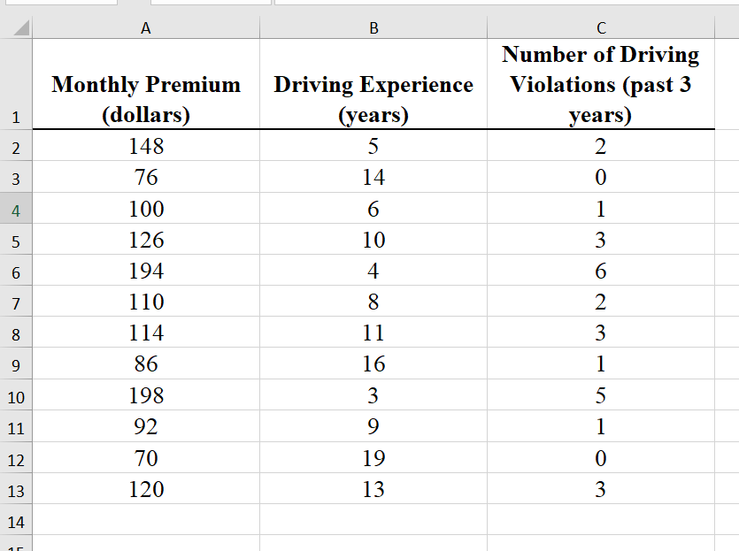
Example 14-1: Solution
.
Prem Mann, Introductory Statistics, 7/E Copyright © 2010 John Wiley & Sons. All right reserved

Slide 34
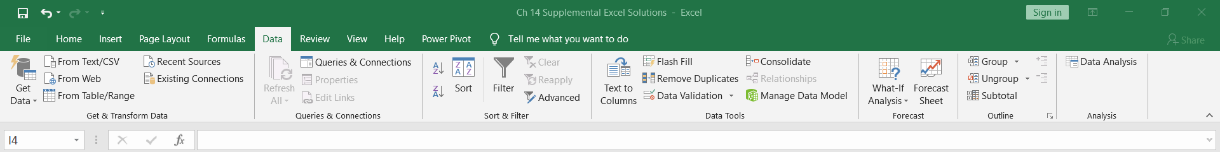
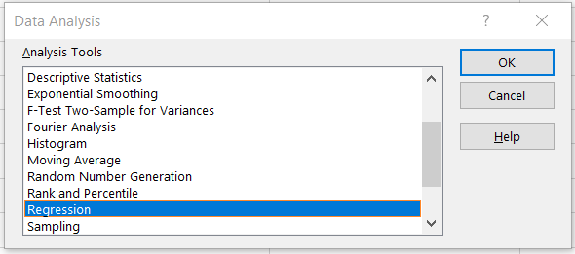
Example 14-1: Solution
To obtain the estimated regression equation, select Data > Data Analysis > Regression.
Prem Mann, Introductory Statistics, 7/E Copyright © 2010 John Wiley & Sons. All right reserved

Slide 35
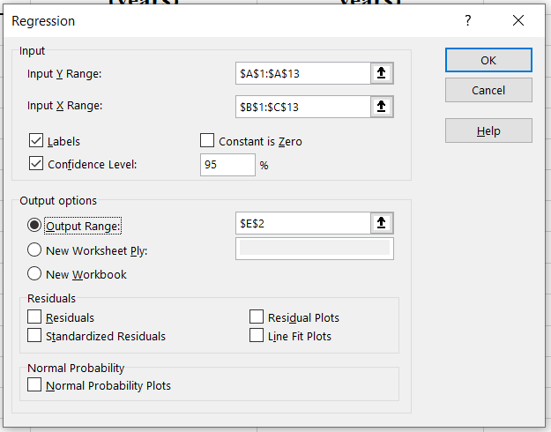
Example 14-1: Solution
Prem Mann, Introductory Statistics, 7/E Copyright © 2010 John Wiley & Sons. All right reserved

Slide 36
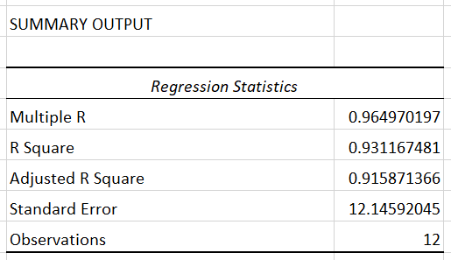


Example 14-1: Solution
R
R²
Number of Observations (a.k.a. sample size)
Prem Mann, Introductory Statistics, 7/E Copyright © 2010 John Wiley & Sons. All right reserved

Slide 37
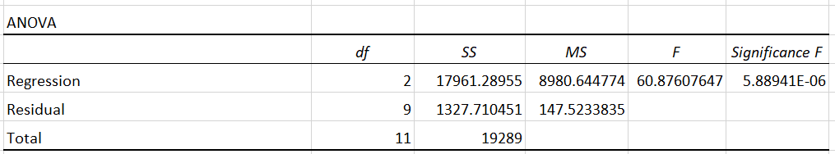
Example 14-1: Solution (this part is frequently skipped)
ANOVA Test Statistic, a.k.a. observed value of F
Numerator df = k - 2
SSR
MSR
Denominator df = n-k-1 = 12 – 2-1
p-value
SST
SSE
MSE
Prem Mann, Introductory Statistics, 7/E Copyright © 2010 John Wiley & Sons. All right reserved

Slide 38
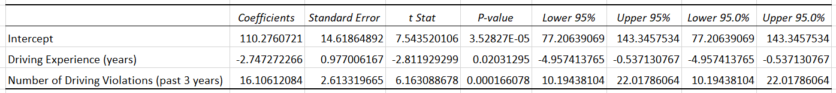
Example 14-1: Solution
Upper limit of 95% confidence interval for B₁
y-intercept a.k.a. constant term a
Lower limit of 95% confidence interval for B₁
S_{b1}
b₁ – coefficient of Driving Experience
Test Statistic of a Hypothesis Test of b₁
b₂ – coefficient of Number of Driving Violations

Slide 39
Example 14-2
Refer to Example 14-1 and the Excel solution
(a) Explain the meaning of the estimated regression coefficients.
(b) What are the values of the standard deviation of errors, the coefficient of multiple determination, and the adjusted coefficient of multiple determination?
Prem Mann, Introductory Statistics, 7/E Copyright © 2010 John Wiley & Sons. All right reserved

Slide 40
Example 14-2
(c) What is the predicted auto insurance premium paid per month by a driver with seven years of driving experience and three driving violations committed in the past three years?
(d) What is the point estimate of the expected (or mean) auto insurance premium paid per month by all drivers with 12 years of driving experience and 4 driving violations committed in the past three years?
Prem Mann, Introductory Statistics, 7/E Copyright © 2010 John Wiley & Sons. All right reserved

Slide 41
Example 14-2: Solution
(a)
a = 110.28, b₁ = -2.7473, b₂ = 16.106.
The estimated regression equation as
Prem Mann, Introductory Statistics, 7/E Copyright © 2010 John Wiley & Sons. All right reserved

Slide 42
Example 14-2: Solution
The value of a = 110.28 in the estimated regression equation gives the value of y for x₁ = 0 and x₂ = 0. Thus, a driver with no driving experience and no driving violations committed in the past three years is expected to pay an auto insurance premium of $110.28 per month.
Prem Mann, Introductory Statistics, 7/E Copyright © 2010 John Wiley & Sons. All right reserved

Slide 43
Example 14-2: Solution
The value of b₁ = -2.7473 in the estimated regression model gives the change in y for a one-unit change in x₁ when x₂ is held constant. Thus, we can state that a driver with one extra year of experience but the same number of driving violations is expected to pay $2.7473 (or $2.75) less per month for the auto insurance premium.
Prem Mann, Introductory Statistics, 7/E Copyright © 2010 John Wiley & Sons. All right reserved

Slide 44
Example 14-2: Solution
The value of b₂ = 16.106 in the estimated regression model gives the change in y for a one-unit change in x₂ when x₁ is held constant. Thus, a driver with one extra driving violation during the past three years but with the same years of driving experience is expected to pay $16.106 (or $16.11) more per month for the auto insurance premium.
Prem Mann, Introductory Statistics, 7/E Copyright © 2010 John Wiley & Sons. All right reserved

Slide 45
Example 14-2: Solution
(b) The values of the standard deviation of errors, the coefficient of multiple determination, and the adjusted coefficient of multiple determination are given in Excel solution. From this part of the solution,
.
Prem Mann, Introductory Statistics, 7/E Copyright © 2010 John Wiley & Sons. All right reserved

Slide 46
Example 14-2: Solution
Note the difference between the Coefficient of Determination and the Adjusted Coefficient of Determination.
The difference is not large.
This model does not include un-important predictor variables.
If the difference were large – model would have included several (possibly many) un-important predictor variables.

Slide 47
Example 14-2: Solution
(c) We substitute x₁ = 7 and x₂ = 3 in the estimated regression model. Thus,
y = 110.28 - 2.7473x₁ + 16.106x₂
= 110.28 - 2.7473(7) + 16.106(3)
= $139.37
Prem Mann, Introductory Statistics, 7/E Copyright © 2010 John Wiley & Sons. All right reserved

Slide 48
Example 14-2: Solution
(d) We substitute x₁ = 12 and x₂ = 4 in the estimated regression model. Thus,
y = 110.28 - 2.7473x₁ + 16.106x₂
= 110.28 - 2.7473(12) + 16.106(4)
= $141.74
Prem Mann, Introductory Statistics, 7/E Copyright © 2010 John Wiley & Sons. All right reserved

Slide 49
Confidence Interval for an Individual Coefficient
Confidence Interval for B_{i}
The (1-α) x 100% confidence interval for B_{i} is given by
The value of t that is used in this formula is obtained from the t distribution table for α/2 area in the right tail of the t distribution curve and (n-k-1) degrees of freedom. The values of b_{i} and s_{bi} are obtained from the computer solution.
Prem Mann, Introductory Statistics, 7/E Copyright © 2010 John Wiley & Sons. All right reserved

Slide 50
Example 14-3
Determine a 95% confidence interval for B₁ (the coefficient of experience) for the multiple regression of auto insurance premium on driving experience and the number of driving violations. Use the Excel solution.
Prem Mann, Introductory Statistics, 7/E Copyright © 2010 John Wiley & Sons. All right reserved

Slide 51
Example 14-1: Solution
Upper limit of 95% confidence interval for B₁
y-intercept a.k.a. constant term a
Lower limit of 95% confidence interval for B₁
S_{b1}
b₁ – coefficient of Driving Experience
Test Statistic of a Hypothesis Test of b₁
b₂ – coefficient of Number of Driving Violations

Slide 52
Example 14-3: Solution
To make a confidence interval for B₁, we use the Excel solution.
b₁ = -2.7473 and s_{b1} = .9770
The confidence level = 95%.
Area in each tail of the t distribution
= (1 - .95) / 2 = .025
n = 12 and k = 2
Degrees of freedom = n - k – 1 = 9
From the t distribution table (Table V), find the value of t for .025 area in the right tail.
Prem Mann, Introductory Statistics, 7/E Copyright © 2010 John Wiley & Sons. All right reserved

Slide 53
Example 14-3: Solution
The 95% confidence interval for B₁ is
b₁ ± t s_{b1} = -2.7473 ± (2.262)(.9770)
= -2.7473 ± 2.2100
= -4.9573 to -.5373
We can state with 95% confidence that for one extra year of driving experience, the monthly auto insurance premium changes by an amount between -$4.96 and -$.54.
Prem Mann, Introductory Statistics, 7/E Copyright © 2010 John Wiley & Sons. All right reserved

Slide 54
Test Statistic for b_{i}
The value of the test statistic t for b_{i} is calculated as
The value of B_{i} is substituted from the null hypothesis. Usually, but not always, the null hypothesis is H₀: B_{i} = 0. The Excel solution contains this value of the test statistic (a.k.a. observed value of t).
Prem Mann, Introductory Statistics, 7/E Copyright © 2010 John Wiley & Sons. All right reserved

Slide 55
Example 14-4
Using the 2.5% significance level, can you conclude that the coefficient of the number of years of driving experience in regression model is negative? Use the Excel output.
Prem Mann, Introductory Statistics, 7/E Copyright © 2010 John Wiley & Sons. All right reserved

Slide 56
Example 14-4: Solution
From Example 14-1, out regression mode (3) is
y = A + B₁ x₁ + B₂ x₂ + ε
From the Excel solution, the estimated regression equation is
y = 110.28 – 2.7473 x₁ + 16.106 x₂
To conduct a test of hypothesis about B₁, we use the Excel solution.
b₁ = -2.7473 and s_{b1} = .9770
Prem Mann, Introductory Statistics, 7/E Copyright © 2010 John Wiley & Sons. All right reserved

Slide 57
Example 14-4: Solution
Step 1:
H₀: B₁ = 0 H₁: B₁ < 0
Step 2:
The sample size is small (n < 30)
σ_{ε} is not known
The sampling distribution of b₁ is normal
We use the t distribution to make a test of hypothesis about B₁
Prem Mann, Introductory Statistics, 7/E Copyright © 2010 John Wiley & Sons. All right reserved

Slide 58
Example 14-4: Solution
Step 3:
The significance level = .025
The < sign in the alternative hypothesis indicates that the test is left-tailed
Degree of freedom
df = n – k – 1 = 12 – 2 – 1 = 9
From the t distribution table (Table V), the critical value of t for 9 df and .025 area in the left tail is t = -2.262
Prem Mann, Introductory Statistics, 7/E Copyright © 2010 John Wiley & Sons. All right reserved

Slide 59
Figure 14.1
Prem Mann, Introductory Statistics, 7/E Copyright © 2010 John Wiley & Sons. All right reserved

Slide 60
Example 14-4: Solution
Step 4:
The value of the test statistic t for b₁ can be obtained from the Excel solution. Thus, the observed value of t is
Prem Mann, Introductory Statistics, 7/E Copyright © 2010 John Wiley & Sons. All right reserved

Slide 61
Example 14-4: Solution
Step 5:
The value of the test statistic t = - 2.81
It is less than the critical value t = -2.262
If falls in the rejection region
We reject the null hypothesis
We conclude that the coefficient of x₁ in regression mode is negative.
Prem Mann, Introductory Statistics, 7/E Copyright © 2010 John Wiley & Sons. All right reserved

Slide 62
Newbold Chapter 12 Example
Savings & Loan

Slide 63
Newbold Ch 12 Example
Develop a model that would predict the annual profit margin for savings and loan associations using data collected over a period of years. An initial model specification indicated that the annual profit margin was related to the net revenue per deposit dollar and the number of savings and loan offices.

Slide 64

Newbold Ch 12 Example
Y= annual profit margin
X₁ = net annual revenue
X₂ = number of savings and loan offices for that year

Slide 65
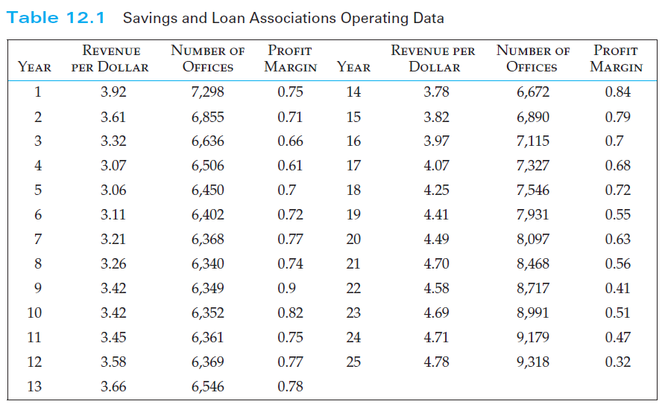
Newbold Ch 12 Example

Slide 66
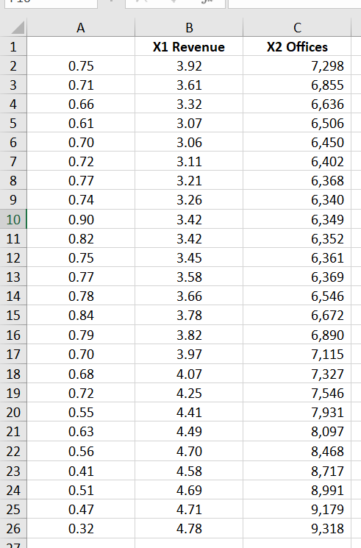
Newbold Ch 12 Example

Slide 67
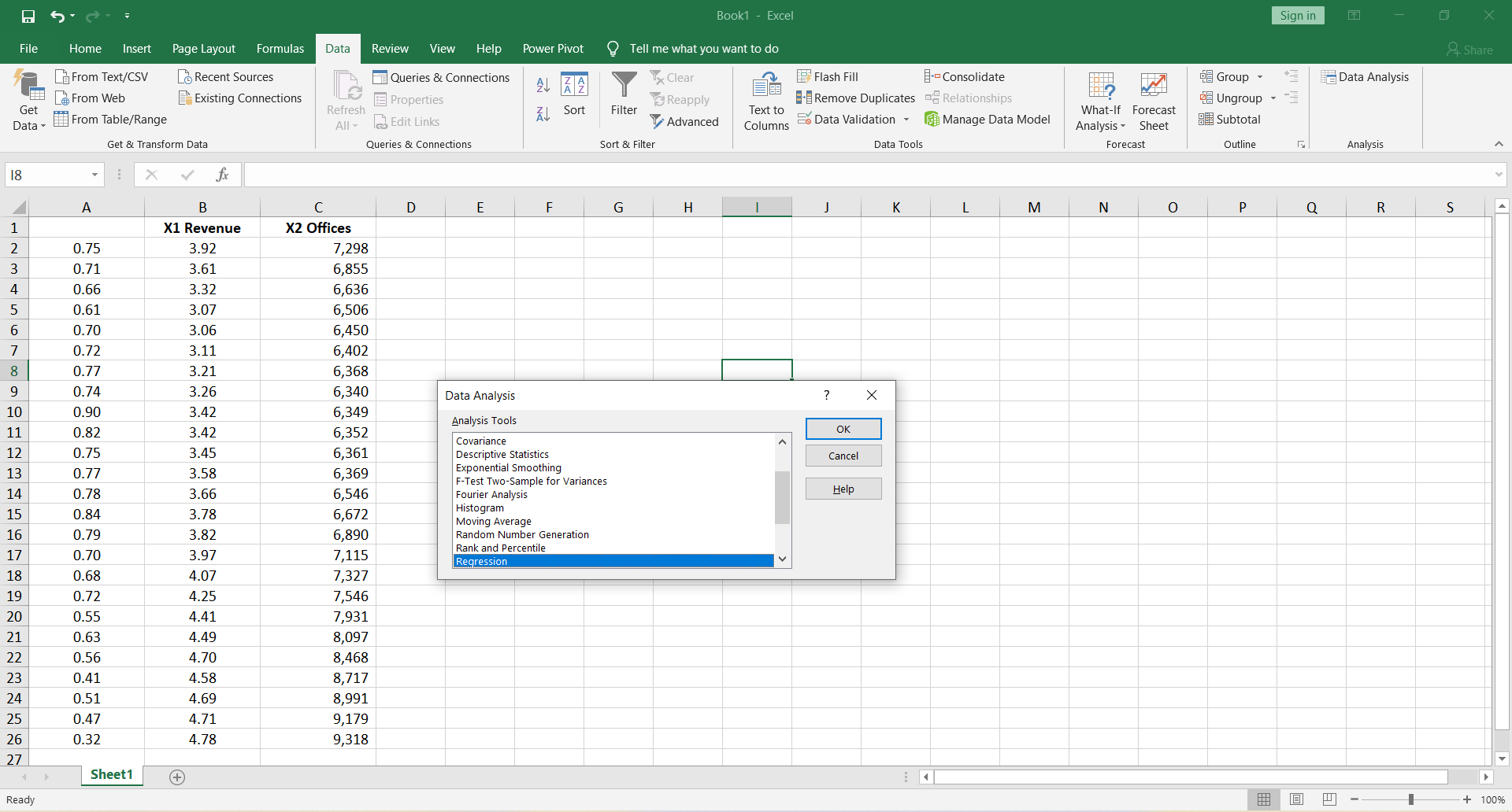
Newbold Ch 12 Example

Slide 68
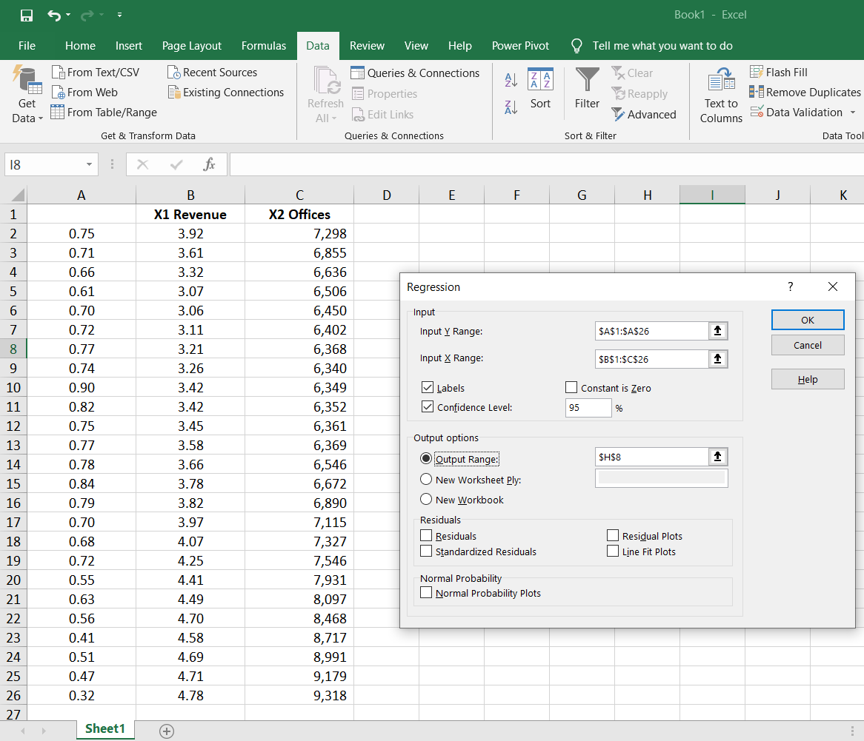
Newbold Ch 12 Example

Slide 69
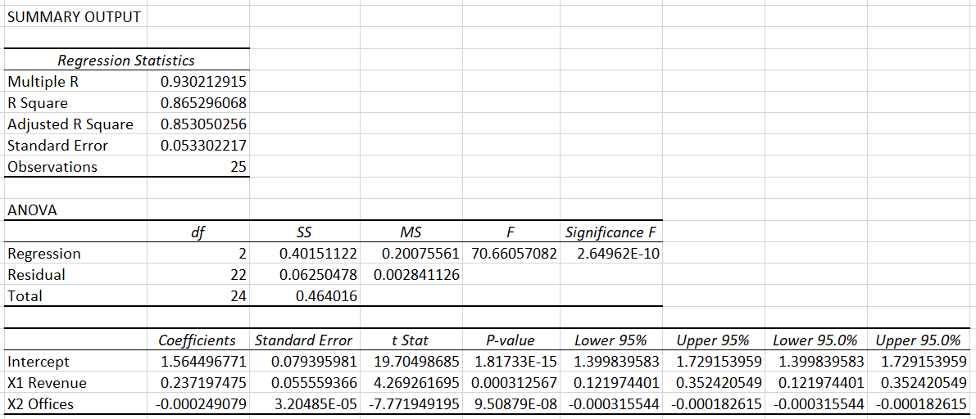
Newbold Ch 12 Example

Slide 70
Newbold Ch 12 Example
Each unit increase in net revenue per deposit dollar, X₁, results in a 0.237 increase in profit margin—if the other variable does not change.
Each unit increase in the number of offices decreases profit margin by 0.000249 —if the other variable does not change.
For this sample: 86.52% of the variability in the savings and loan association’s profit is explained by the linear relationships with net revenues and number of offices.

Slide 71
Newbold Ch 12 Example
Compare the multiple regression coefficients with two simple linear regression coefficients:
Profit vs. Revenue
Profit vs. Offices

Slide 72
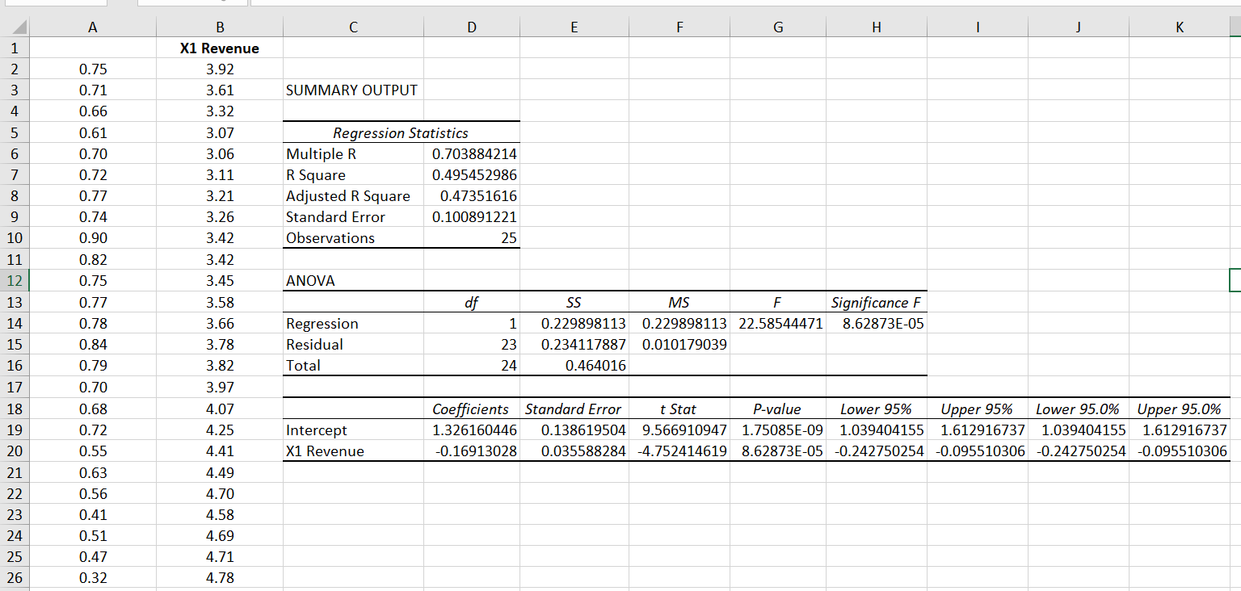
Newbold Ch 12 Example
Simple Regression: Profit vs. Revenue

Slide 73
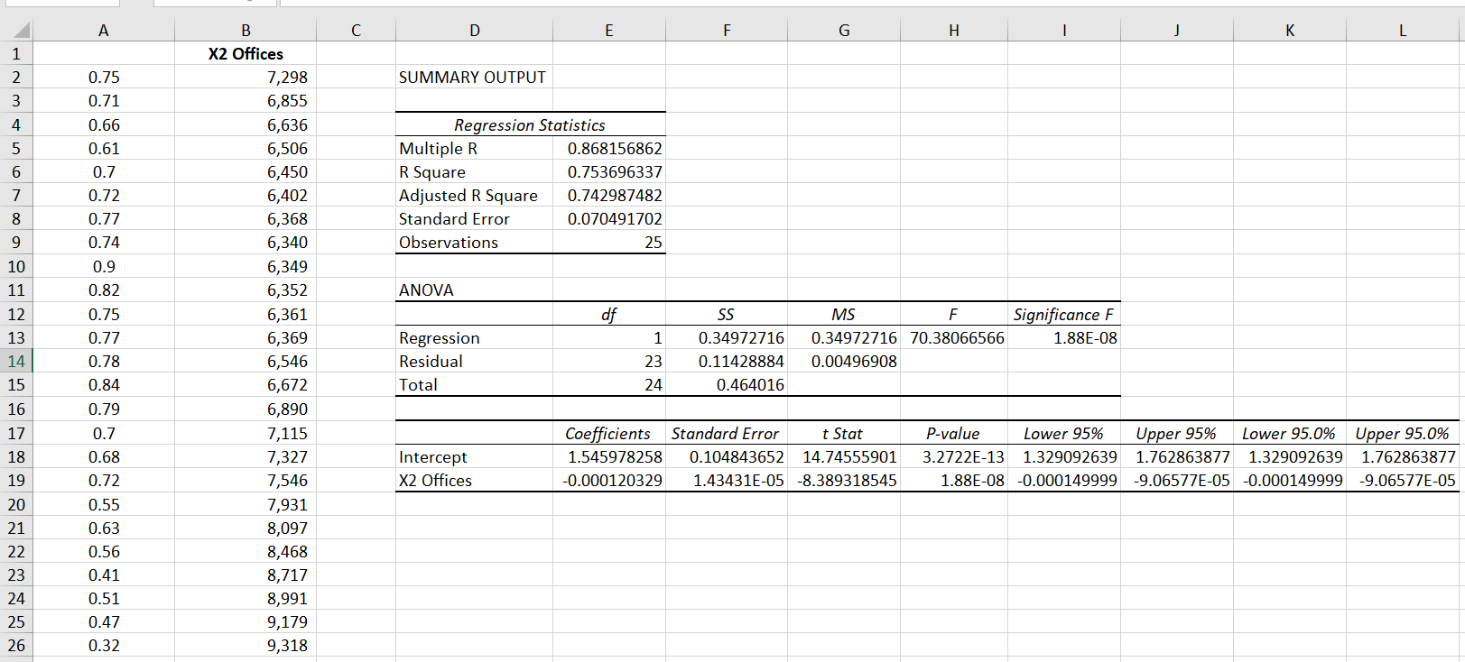
Newbold Ch 12 Example
Simple Regression: Profit vs. Offices

Slide 74
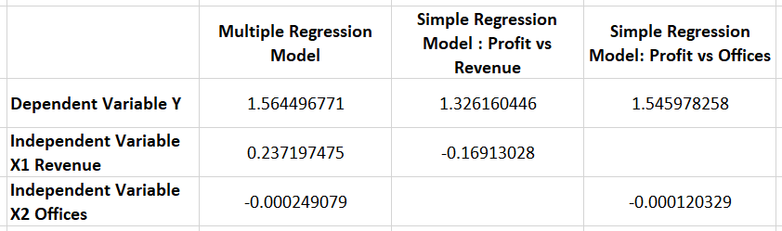
Newbold Ch 12 Example
Multiple Regression Coefficients compared to the two Simple Regression Coefficients
The multiple regression coefficients are different from the simple regression coefficients.
This change in coefficients, results from the high correlation between the independent variables.

Slide 75
Newbold Ch 12 Example Takeaways
The multiple regression coefficients are conditional coefficients:
The estimated coefficient b₁ depends on the other independent variables included in the model.
This will always be the case in multiple regression unless two independent variables have a sample correlation of zero—a very unlikely event.
Regression coefficient estimates are always conditional on the other predictor variables in the model.
Proper model specification—that is, choice of predictor variables—is very important.
Model specification requires an understanding of the problem context and appropriate theory.

Slide 76


Newbold Ch 12 Example
Predict the revenue if X₁ is 3.92 and X₂ is 7,298
Rounded to three decimals (to be consistent with the Newbold textbook)

Slide 77
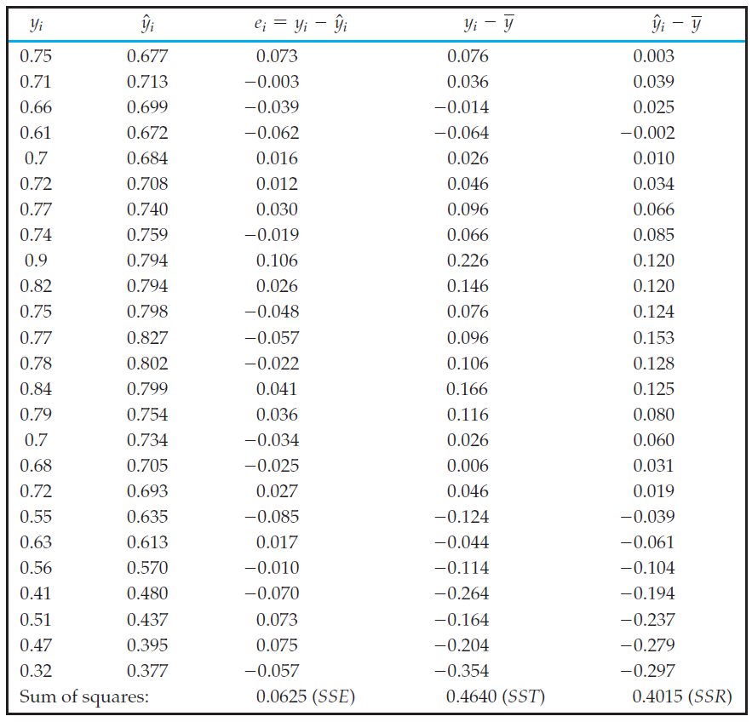
Newbold Ch 12 Example

Slide 78
Newbold Ch 12 Example Takeaway
Coefficient of Determination = 86.52%
Adjusted Coefficient of Determination = 85.31%
In this example the difference between R² and Adjusted R² is not very large.
This example’s model did not include unimportant independent variables.
However, if the regression model had contained a number of independent variables that were not important conditional predictors, then the difference would be substantial.

