Slide 1
CHAPTER 9
HYPOTHESIS TESTS ABOUT THE MEAN AND PROPORTION:
SINGLE POPULATION
Prem Mann, Introductory Statistics, 7/E Copyright © 2010 John Wiley & Sons. All right reserved

Slide 2
HYPOTHESIS TESTS: AN INTRODUCTION
Two Hypotheses
Rejection and Nonrejection Regions
Two Types of Errors
Tails of a Test
Prem Mann, Introductory Statistics, 7/E Copyright © 2010 John Wiley & Sons. All right reserved

Slide 3
Two Hypotheses
Definition
A null hypothesis is a claim (or statement) about a population parameter that is assumed to be true until it is declared false.
H₀
Prem Mann, Introductory Statistics, 7/E Copyright © 2010 John Wiley & Sons. All right reserved

Slide 4
Two Hypotheses
Definition
An alternative hypothesis is a claim about a population parameter that will be true if the null hypothesis is false.
H₁
Prem Mann, Introductory Statistics, 7/E Copyright © 2010 John Wiley & Sons. All right reserved

Slide 5
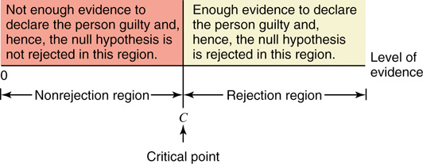
Rejection and Nonrejection Regions
Figure 9.1 Nonrejection and rejection regions for the court case.
Prem Mann, Introductory Statistics, 7/E Copyright © 2010 John Wiley & Sons. All right reserved

Slide 6
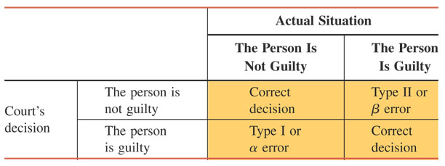
Two Types of Errors
Table 9.1 Four Possible Outcomes for a Court Case
Prem Mann, Introductory Statistics, 7/E Copyright © 2010 John Wiley & Sons. All right reserved

Slide 7
Two Types of Errors
Definition
A Type I error occurs when a true null hypothesis is rejected. The value of α represents the probability of committing this type of error; that is,
α = P(H₀ is rejected | H₀ is true)
The value of α represents the significance level of the test.
Prem Mann, Introductory Statistics, 7/E Copyright © 2010 John Wiley & Sons. All right reserved

Slide 8
Two Types of Errors
Definition
A Type II error occurs when a false null hypotheses is not rejected. The value of β represents the probability of committing a Type II error; that is,
β = P (H₀ is not rejected | H₀ is false)
The value of 1 – β is called the power of the test. It represents the probability of not making a Type II error.
Prem Mann, Introductory Statistics, 7/E Copyright © 2010 John Wiley & Sons. All right reserved

Slide 9
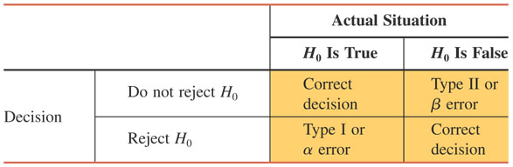
Table 9.2 Four Possible Outcomes for a Test of Hypothesis
Prem Mann, Introductory Statistics, 7/E Copyright © 2010 John Wiley & Sons. All right reserved

Slide 10
Tails of a Test
Definition
A two-tailed test has rejection regions in both tails, a left-tailed test has the rejection region in the left tail, and a right-tailed test has the rejection region in the right tail of the distribution curve.
Prem Mann, Introductory Statistics, 7/E Copyright © 2010 John Wiley & Sons. All right reserved

Slide 11
A Two-Tailed Test
According to a survey by Consumer Reports magazine conducted in 2008, a sample of sixth graders selected from New York schools showed that their backpacks weighed an average of 18.4 pounds (USA TODAY, August 3, 2009). Another magazine wants to check whether or not this mean has changed since that survey. The key word here is changed.
The mean weight of backpacks for sixth-graders in New York has changed if it has either increased or decreased since 2008. This is an example of a two tailed test.
Prem Mann, Introductory Statistics, 7/E Copyright © 2010 John Wiley & Sons. All right reserved

Slide 12
A Two-Tailed Test
Let μ be the weight of backpacks for the current sixth-graders in New York. The two possible decisions are
  H₀ : μ = 18.4 pounds (The mean weight of backpacks for sixth-graders in New York has not changed)
  H₁ : μ ≠ 18.4 pounds (The mean weight of backpacks for sixth-graders in New York has changed)
Prem Mann, Introductory Statistics, 7/E Copyright © 2010 John Wiley & Sons. All right reserved

Slide 13
A Two-Tailed Test
Whether a test is two–tailed or one–tailed is determined by the sign in the alternative hypothesis.
If the alternative hypothesis has a not equal to (≠) sign, it is a two–tailed test.
Prem Mann, Introductory Statistics, 7/E Copyright © 2010 John Wiley & Sons. All right reserved

Slide 14
Figure 9.2 A two-tailed test.
Prem Mann, Introductory Statistics, 7/E Copyright © 2010 John Wiley & Sons. All right reserved

Slide 15
A Left-Tailed Test
Reconsider the example of the mean amount of soda in all soft-drink cans produced by a company. The company claims that these cans, on average, contain 12 ounces of soda. However, if these cans contain less than the claimed amount of soda, then the company can be accused of cheating. Suppose a consumer agency wants to test whether the mean amount of soda per can is less than 12 ounces. Note that the key phrase this time is less than, which indicates a left-tailed test.
Prem Mann, Introductory Statistics, 7/E Copyright © 2010 John Wiley & Sons. All right reserved

Slide 16
A Left-Tailed Test
Let μ be the mean amount of soda in all cans. The two possible decisions are
  H₀ : μ = 12 ounces (The mean is equal to 12 ounces)
  H₁ : μ < 12 ounces (The mean is less than 12 ounces)
Prem Mann, Introductory Statistics, 7/E Copyright © 2010 John Wiley & Sons. All right reserved

Slide 17
A Left-Tailed Test
In this case, we can also write the null hypothesis as H₀ : μ ≥ 12. This will not affect the result of the test as long as the sign in H₁ is less than (<).
When the alternative hypothesis has a less than (<) sign, the test is always left–tailed.
Prem Mann, Introductory Statistics, 7/E Copyright © 2010 John Wiley & Sons. All right reserved

Slide 18
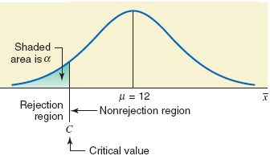
Figure 9.3 A left-tailed test.
Prem Mann, Introductory Statistics, 7/E Copyright © 2010 John Wiley & Sons. All right reserved

Slide 19
A Right-Tailed Test
According to www.city-data.com, the average price of homes in West Orange, New Jersey, was $461,216 in 2007. Suppose a real estate researcher wants to check whether the current mean price of homes in this town is higher than $461,216. The key phrase in this case is higher than, which indicates a right-tailed test.
Prem Mann, Introductory Statistics, 7/E Copyright © 2010 John Wiley & Sons. All right reserved

Slide 20
A Right-Tailed Test
Let μ be the current mean price of homes in this town. The two possible decisions are
  H₀ : μ = $461,216 (The current mean price of homes in this town is not higher than $461,216)
  H₁ : μ > $461,216 (The current mean price of homes in this town is higher than $461,216)
Prem Mann, Introductory Statistics, 7/E Copyright © 2010 John Wiley & Sons. All right reserved

Slide 21
A Right-Tailed Test
When the alternative hypothesis has a greater than (>) sign, the test is always right–tailed.
Prem Mann, Introductory Statistics, 7/E Copyright © 2010 John Wiley & Sons. All right reserved

Slide 22
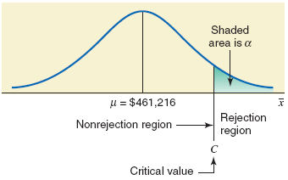
Figure 9.4 A right-tailed test.
Prem Mann, Introductory Statistics, 7/E Copyright © 2010 John Wiley & Sons. All right reserved

Slide 23
Summary of tests and the Significance Level (α)

Slide 24
A null hypothesis is a claim (or statement) about a population parameter that is assumed to be true until it is declared false. (H_{o})
An alternative hypothesis is a claim about a population parameter that will be true if the null hypothesis is false. (H₁)

Slide 25
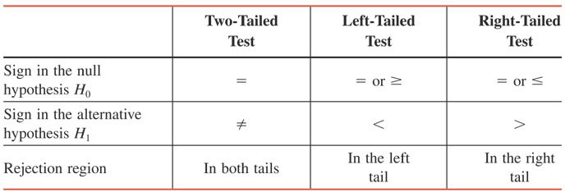
Table 9.3 Signs in H₀ and H₁ and Tails of a Test
Prem Mann, Introductory Statistics, 7/E Copyright © 2010 John Wiley & Sons. All right reserved

Slide 26
H₀, H₁, and Tails of a Test

Slide 27
H₀, H₁, and Tails of a Test
The manufacturer of a certain brand of auto batteries claims that the mean life of these batteries is 45 months. A consumer protection agency that wants to check this claim took a random sample of 24 such batteries and found that the mean life for this sample is 43.05 months. The lives of all such batteries have a normal distribution with the population standard deviation of 4.5 months. Perform a test of hypothesis with the alternative hypothesis that the mean life of these batteries is less than 45 months.

Slide 28
H₀, H₁, and Tails of a Test
According to the U.S. Bureau of Labor Statistics, all workers in America who had a bachelor’s degree and were employed earned an average of $1038 a week in 2010. A recent sample of 400 American workers who have a bachelor’s degree showed that they earn an average of $1060 per week. Suppose that the population standard deviation of such earnings is $160. Perform a test of hypothesis with the alternative hypothesis that the current mean weekly earning of American workers who have a bachelor’s degree is higher than $1038.

Slide 29
H₀, H₁, and Tails of a Test
A telephone company claims that the mean duration of all long-distance phone calls made by its residential customers is 10 minutes. A random sample of 100 long-distance calls made by its residential customers taken from the records of this company showed that the mean duration of calls for this sample is 9.20 minutes. The population standard deviation is known to be 3.80 minutes. Test if the mean duration of all long-distance calls made by residential customers of this company is different from 10 minutes.

Slide 30
H₀, H₁, and Tails of a Test
Records in a three-county area show that in the last few years, Girl Scouts sold an average of 47.93 boxes of cookies per year per girl scout, with a population standard deviation of 8.45 boxes per year. Fifty randomly selected Girl Scouts from the region sold an average of 46.54 boxes this year. Scout leaders are concerned that the demand for Girl Scout cookies may have decreased. Test at a 10% significance level whether the average number of boxes of cookies sold by all Girl Scouts in the three-county area is lower than the historical average of 47.93.

Slide 31
H₀, H₁, and Tails of a Test
A study claims that all homeowners in a town spend an average of 8 hours or more on house cleaning and gardening during a weekend. A researcher wanted to check if this claim is true. A random sample of 20 homeowners taken by this researcher showed that they spend an average of 7.68 hours on such chores during a weekend. The population of such times for all homeowners in this town is normally distributed with the population standard deviation of 2.1 hours.
Using a 1% significance level, can you conclude that the claim that all homeowners spend an average of 8 hours or more on such chores during a weekend is false?

Slide 32
H₀, H₁, and Tails of a Test
According to an estimate, the average age at first marriage for women in the United States was 26.1 years in 2010 (Time, March 21, 2011). A recent sample of 60 women from New Jersey who got married for the first time this year showed that their average age at first marriage was 27.2 years with a standard deviation of 3.5 years. Using a 2.5% significance level and the critical-value approach, can you conclude that the average age for women in New Jersey who got married for the first time this year is higher than 26.1 years?

Slide 33
H₀, H₁, and Tails of a Test
The mean balance of all checking accounts at a bank on December 31, 2011, was $850. A random sample of 55 checking accounts taken recently from this bank gave a mean balance of $780 with a standard deviation of $230. Using a 1% significance level, can you conclude that the mean balance of such accounts has decreased during this period?

Slide 34
H₀, H₁, and Tails of a Test
According to an estimate, the average price of homes in Martha’s Vineyard, Massachusetts, was $650,000 in 2011 (USA TODAY, August 11, 2011). A recent random sample of 70 homes from Martha’s Vineyard showed that their average price is $674,000 with a standard deviation of $94,500. Using a 2% significance level, can you conclude that the current average price of homes in Martha’s Vineyard is different from $650,000?

Slide 35
H₀, H₁, and Tails of a Test
The manager of a restaurant in a large city claims that waiters working in all restaurants in his city earn an average of $150 or more in tips per week. A random sample of 25 waiters selected from restaurants of this city yielded a mean of $139 in tips per week with a standard deviation of $28. Assume that the weekly tips for all waiters in this city have a normal distribution. Using a 1% significance level, can you conclude that the manager’s claim is true?

Slide 36
H₀, H₁, and Tails of a Test
A tool manufacturing company claims that its top-of-the-line machine that is used to manufacture bolts produces an average of 88 or more bolts per hour. A company that is interested in buying this machine wants to check this claim.

Slide 37
HYPOTHESIS TESTS ABOUT :  KNOWN
Three Possible Cases
Case I. If the following three conditions are fulfilled:
1. The population standard deviation σ is known
2. The sample size is small (i.e., n < 30)
3. The population from which the sample is selected is normally distributed.
Prem Mann, Introductory Statistics, 7/E Copyright © 2010 John Wiley & Sons. All right reserved

Slide 38
HYPOTHESIS TESTS ABOUT μ: σ KNOWN
Three Possible Cases
Case II. If the following two conditions are fulfilled:
1. The population standard deviation σ is known
2. The sample size is large (i.e., n ≥ 30)
Prem Mann, Introductory Statistics, 7/E Copyright © 2010 John Wiley & Sons. All right reserved

Slide 39
HYPOTHESIS TESTS ABOUT μ: σ KNOWN
Three Possible Cases
Case III. If the following three conditions are fulfilled:
1. The population standard deviation σ is known
2. The sample size is small (i.e., n < 30)
3. The population from which the sample is selected is not normally distributed (or its distribution is unknown).
Prem Mann, Introductory Statistics, 7/E Copyright © 2010 John Wiley & Sons. All right reserved

Slide 40
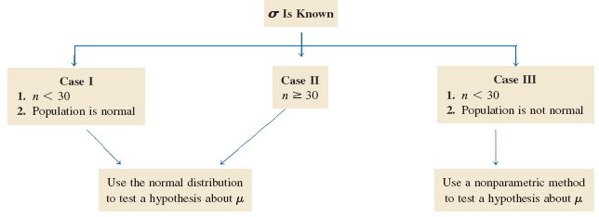
HYPOTHESIS TESTS ABOUT μ: σ KNOWN
Three Possible Cases
Prem Mann, Introductory Statistics, 7/E Copyright © 2010 John Wiley & Sons. All right reserved

Slide 41
Calculating the z Value for x
When using the normal distribution, the value of z for x for a test of hypothesis about μ is computed as follows:
The value of z calculated for x using this formula is also called the observed value of z_{o}.
Prem Mann, Introductory Statistics, 7/E Copyright © 2010 John Wiley & Sons. All right reserved

Slide 42
HYPOTHESIS TESTS ABOUT :  NOT KNOWN
Three Possible Cases
Case I. If the following three conditions are fulfilled:
1. The population standard deviation σ is not known
2. The sample size is small (i.e., n < 30)
3. The population from which the sample is selected is normally distributed.
Prem Mann, Introductory Statistics, 7/E Copyright © 2010 John Wiley & Sons. All right reserved

Slide 43
HYPOTHESIS TESTS ABOUT μ: σ NOT KNOWN
Three Possible Cases
Case II. If the following two conditions are fulfilled:
1. The population standard deviation σ is not known
2. The sample size is large (i.e., n ≥ 30)
Prem Mann, Introductory Statistics, 7/E Copyright © 2010 John Wiley & Sons. All right reserved

Slide 44
HYPOTHESIS TESTS ABOUT μ: σ NOT KNOWN
Three Possible Cases
Case III. If the following three conditions are fulfilled:
1. The population standard deviation σ is not known
2. The sample size is small (i.e., n < 30)
3. The population from which the sample is selected is not normally distributed (or its distribution is unknown).
Prem Mann, Introductory Statistics, 7/E Copyright © 2010 John Wiley & Sons. All right reserved

Slide 45
HYPOTHESIS TESTS ABOUT μ: σ NOT KNOWN
Three Possible Cases
Prem Mann, Introductory Statistics, 7/E Copyright © 2010 John Wiley & Sons. All right reserved

Slide 46
HYPOTHESIS TESTS ABOUT μ: σ NOT KNOWN
Test Statistic
The value of the test statistic t for the sample mean x is computed as
The value of t calculated for x by using this formula is also called the observed value of t.
Prem Mann, Introductory Statistics, 7/E Copyright © 2010 John Wiley & Sons. All right reserved

Slide 47
Tests of Hypothesis for μ Using the t Distribution
What If the Sample Size Is Too Large?
1. Use the t value from the last row (the row of ∞) in Table V of Appendix C.
2. Use the normal distribution as an approximation to the t distribution.
Prem Mann, Introductory Statistics, 7/E Copyright © 2010 John Wiley & Sons. All right reserved

Slide 48
HYPOTHESIS TESTS ABOUT A POPULATION PROPORTION: LARGE SAMPLES
Test Statistic
We use the Standard Normal Distribution if the sample is normally distributed or approximately normally distributed.
np>5 AND nq>5
p is population proportion (from H_{o})
q = 1 – p
n is sample size
Prem Mann, Introductory Statistics, 7/E Copyright © 2010 John Wiley & Sons. All right reserved

Slide 49
HYPOTHESIS TESTS ABOUT A POPULATION PROPORTION: LARGE SAMPLES
Test Statistic
The value of the test statistic z for the sample proportion, , is computes as
The value of p that is used in this formula is the one from the null hypothesis. The value of q is equal to 1-p. The value of z calculated for using the above formula is also called the observed value of z.
Prem Mann, Introductory Statistics, 7/E Copyright © 2010 John Wiley & Sons. All right reserved

Slide 50
The Two Approaches

Slide 51
Two Procedures
Two procedures to make tests of hypothesis
1. The p-value approach
2. The critical-value approach
Prem Mann, Introductory Statistics, 7/E Copyright © 2010 John Wiley & Sons. All right reserved

Slide 52
HYPOTHESIS TESTS ABOUT μ: σ KNOWN
Definition
Assuming that the null hypothesis is true, the p-value can be defined as the probability that a sample statistic (such as the sample mean) is at least as far away from the hypothesized value in the direction of the alternative hypothesis as the one obtained from the sample data under consideration. Note that the p–value is the smallest significance level at which the null hypothesis is rejected.
Prem Mann, Introductory Statistics, 7/E Copyright © 2010 John Wiley & Sons. All right reserved

Slide 53
The p-value approach
We calculate the observed value of z or t from the sample statistic. We identify this as z_{o} or t_{o}.
We calculate the p-value of the sample statistics (from z_{o} or t_{o}) and compare with the α.
  If p-value< α or if α > p-value – reject the Null Hypothesis.
  If p-value≥ α or if α≤p-value – do not reject the Null Hypothesis.

Slide 54
Steps to Perform a Test of Hypothesis Using the p–Value Approach
State the null and alternative hypothesis.
Select the type of test to use: two-tailed or right-tailed or left-tailed.
Select the distribution to use.
Calculate the p–value.
Make a decision.
Prem Mann, Introductory Statistics, 7/E Copyright © 2010 John Wiley & Sons. All right reserved

Slide 55
Figure 9.5 The p–value for a right-tailed test.
Prem Mann, Introductory Statistics, 7/E Copyright © 2010 John Wiley & Sons. All right reserved

Slide 56
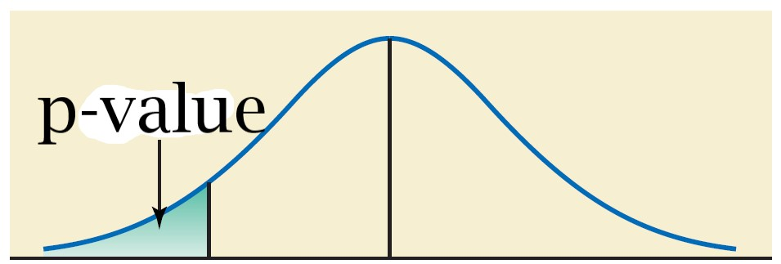
Figure 9.5 The p–value for a left-tailed test.
Prem Mann, Introductory Statistics, 7/E Copyright © 2010 John Wiley & Sons. All right reserved

Slide 57
Figure 9.6 The p–value for a two-tailed test.
Prem Mann, Introductory Statistics, 7/E Copyright © 2010 John Wiley & Sons. All right reserved

Slide 58
The Critical Value Approach
Given the α, we establish rejection and non-rejection regions. We identify the critical values of z or t that separate the rejection region(s) from the non-rejection region. We identify the critical value(s) as z_{c} or t_{c}.
Then we calculate the observed value (z or t) for the sample statistic. We identify these observed values as z_{o} or t_{o}.
Given the location of the observed value, we reject or do not reject the Null Hypothesis.

Slide 59
Steps to Perform a Test of Hypothesis with the Critical-Value Approach
  State the null and alternative hypotheses.
  Determine the appropriate test: two-tailed or right-tailed or left-tailed.
  Select the distribution to use.
  Determine the rejection and non-rejection regions.
  Calculate the value of the test statistic.
  Make a decision.
Prem Mann, Introductory Statistics, 7/E Copyright © 2010 John Wiley & Sons. All right reserved

Slide 60
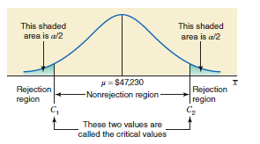
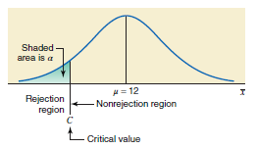
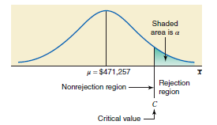
Two-tailed test
Left-tailed test
Right-tailed test

Slide 61
EXAMPLES

Slide 62
Example 9-1
At Canon Food Corporation, it used to take an average of 90 minutes for new workers to learn a food processing job. Recently the company installed a new food processing machine. The supervisor at the company wants to find if the mean time taken by new workers to learn the food processing procedure on this new machine is different from 90 minutes. A sample of 20 workers showed that it took, on average, 85 minutes for them to learn the food processing procedure on the new machine. It is known that the learning times for all new workers are normally distributed with a population standard deviation of 7 minutes. Find the p–value for the test that the mean learning time for the food processing procedure on the new machine is different from 90 minutes. What will your conclusion be if α = .01?
Prem Mann, Introductory Statistics, 7/E Copyright © 2010 John Wiley & Sons. All right reserved

Slide 63
Example 9-1: Solution
Step 1: H₀: μ = 90 H₁: μ ≠ 90
Step 2: Because the sign in the alternative hypothesis is ≠, the appropriate test is a two-tailed test.
Step 3: The population standard deviation σ is known, the sample size is small (n < 30), but the population distribution is normal. We will use the normal distribution to find the p–value and make the test.
Prem Mann, Introductory Statistics, 7/E Copyright © 2010 John Wiley & Sons. All right reserved

Slide 64
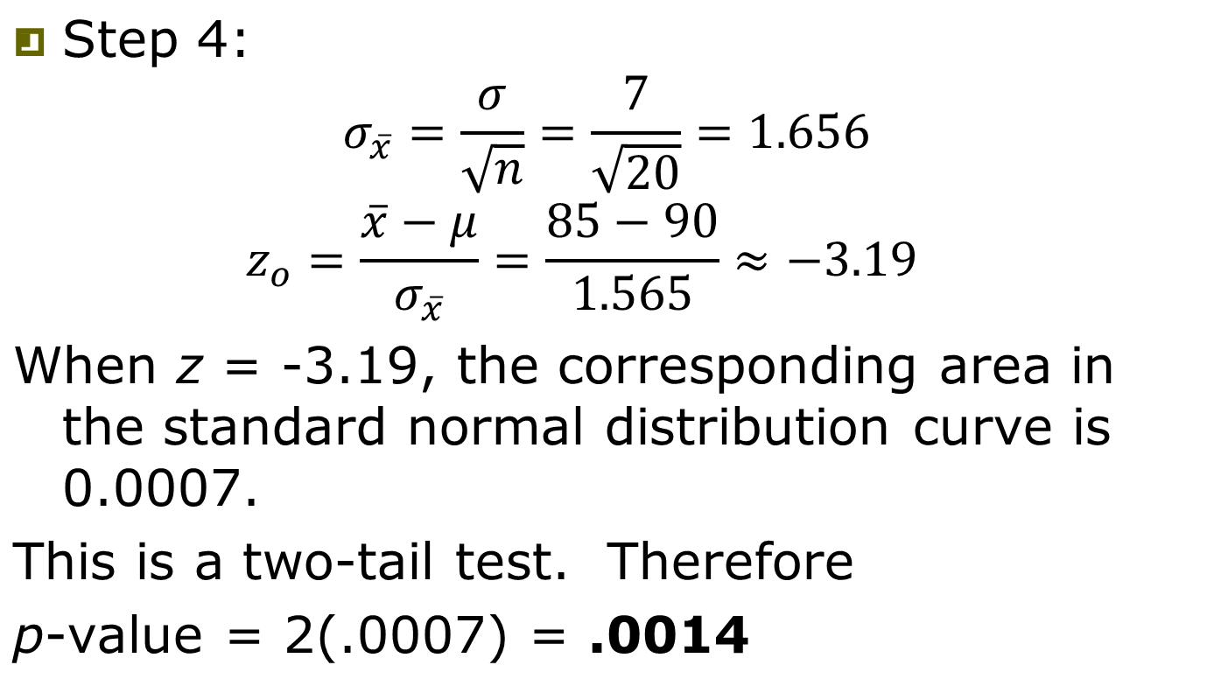
Example 9-1: Solution
1.565
Prem Mann, Introductory Statistics, 7/E Copyright © 2010 John Wiley & Sons. All right reserved

Slide 65
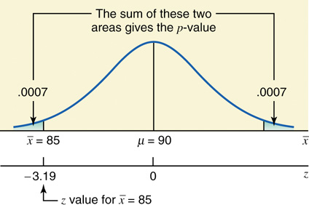
Figure 9-7 The p-value for a two-tailed test.
Prem Mann, Introductory Statistics, 7/E Copyright © 2010 John Wiley & Sons. All right reserved

Slide 66
Example 9-1: Solution
Step 5: Because α = .0100 is greater than the p-value of .0014, we reject the null hypothesis at this significance level.
Therefore, we conclude that the mean time for learning the food processing procedure on the new machine is different from 90 minutes.
Prem Mann, Introductory Statistics, 7/E Copyright © 2010 John Wiley & Sons. All right reserved

Slide 67
Example 9-2
The management of Priority Health Club claims that its members lose an average of 10 pounds or more within the first month after joining the club. A consumer agency that wanted to check this claim took a random sample of 36 members of this health club and found that they lost an average of 9.2 pounds within the first month of membership with a population standard deviation of 2.4 pounds. Find the p–value for this test. What will you decision be if α = .01? What if α = .05?
Prem Mann, Introductory Statistics, 7/E Copyright © 2010 John Wiley & Sons. All right reserved

Slide 68
Example 9-2: Solution
Step 1: H₀: μ ≥ 10 H₁: μ < 10
Step 2: Because there is the < sign in H₁, the left-tailed test is appropriate.
Step 3: The population standard deviation σ is known, the sample size is large (n > 30). Due to the Central Limit Theorem, we will use the Standard Normal Distribution to find the p–value and perform the test.
Prem Mann, Introductory Statistics, 7/E Copyright © 2010 John Wiley & Sons. All right reserved

Slide 69
Example 9-2: Solution
Step 4:
Looking up the Standard Normal Distribution Table: when z_{o} = -2.00 the area under the curve is 0.0228.
This is a left-tail test (i.e., single tail). Therefore, p-value = .0228
Prem Mann, Introductory Statistics, 7/E Copyright © 2010 John Wiley & Sons. All right reserved

Slide 70
Figure 9-8 The p-value for a left-tailed test.
Prem Mann, Introductory Statistics, 7/E Copyright © 2010 John Wiley & Sons. All right reserved

Slide 71
Example 9-2: Solution
Step 5:
Since α = .01 is less than the p-value of .0228, we do not reject the null hypothesis at this significance level. Consequently, we conclude that the mean weight lost within the first month of membership by the members of this club is 10 pounds or more.
Because α = .05 is greater than the p-value of .0228, we reject the null hypothesis at this significance level. Therefore, we conclude that the mean weight lost within the first month of membership by the members of this club is less than 10 pounds.
Prem Mann, Introductory Statistics, 7/E Copyright © 2010 John Wiley & Sons. All right reserved

Slide 72
HYPOTHESIS TESTS ABOUT μ: σ KNOWN
Test Statistic
In tests of hypotheses about μ using the normal distribution, the random variable
is called the test statistic. The test statistic can be defined as a rule or criterion that is used to make the decision whether or not to reject the null hypothesis.
Prem Mann, Introductory Statistics, 7/E Copyright © 2010 John Wiley & Sons. All right reserved

Slide 73
Example 9-3
The TIV Telephone Company provides long-distance telephone service in an area. According to the company’s records, the average length of all long-distance calls placed through this company in 2009 was 12.44 minutes. The company’s management wanted to check if the mean length of the current long-distance calls is different from 12.44 minutes. A sample of 150 such calls placed through this company produced a mean length of 13.71 minutes. It is known that the standard deviation of all calls is 2.65 minutes. Using the 2% significance level, can you conclude that the mean length of all current long-distance calls is different from 12.44 minutes?
Prem Mann, Introductory Statistics, 7/E Copyright © 2010 John Wiley & Sons. All right reserved

Slide 74
Example 9-3: Solution
Step 1: H₀ : μ = 12.44 H₁ : μ ≠ 12.44
Step 2: Because there is the ≠ sign in the H₁, the two-tailed test is appropriate.
Step 3: The population standard deviation σ is known, and the sample size is large (n > 30). Due to the Central Limit Theorem, we will use the normal distribution to perform the test.
Prem Mann, Introductory Statistics, 7/E Copyright © 2010 John Wiley & Sons. All right reserved

Slide 75
Example 9-3: Solution
Step 4: α = .02
Area in each tail = α / 2= .02 / 2 = .0100
The z values for the two critical points are -2.33 and 2.33
Prem Mann, Introductory Statistics, 7/E Copyright © 2010 John Wiley & Sons. All right reserved

Slide 76
Figure 9.9
Prem Mann, Introductory Statistics, 7/E Copyright © 2010 John Wiley & Sons. All right reserved

Slide 77
Calculating the Value of the Test Statistic
When using the normal distribution, the value of the test statistic z for x for a test of hypothesis about μ is computed as follows:
The value of z for x is also called the observed value of z.
Prem Mann, Introductory Statistics, 7/E Copyright © 2010 John Wiley & Sons. All right reserved

Slide 78
Example 9-3: Solution
Step 5:
Prem Mann, Introductory Statistics, 7/E Copyright © 2010 John Wiley & Sons. All right reserved

Slide 79
Example 9-3: Solution
Step 6: This value of z_{o} = 5.87 is greater than the critical value of z_{c} = 2.33, and it falls in the rejection region in the right tail in Figure 9.9. Hence, we reject H₀ and conclude that based on the sample information, it appears that the mean length of all such calls is not equal to 12.44 minutes.
Prem Mann, Introductory Statistics, 7/E Copyright © 2010 John Wiley & Sons. All right reserved

Slide 80
Example 9-4
The mayor of a large city claims that the average net worth of families living in this city is at least $300,000. A random sample of 25 families selected from this city produced a mean net worth of $288,000. Assume that the net worths of all families in this city have a normal distribution with the population standard deviation of $80,000. Using the 2.5% significance level, can you conclude that the mayor’s claim is false?
Prem Mann, Introductory Statistics, 7/E Copyright © 2010 John Wiley & Sons. All right reserved

Slide 81
Example 9-4: Solution
Step 1: H₀ : μ ≥ $300,000
H₁ : μ < $300,000
Step 2: Left-tailed test is appropriate.
Step 3: The population standard deviation σ is known, the sample size is small (n < 30), but the population distribution is normal. Consequently, we will use the normal distribution to perform the test.
Prem Mann, Introductory Statistics, 7/E Copyright © 2010 John Wiley & Sons. All right reserved

Slide 82
Example 9-4: Solution
Step 4: α = .0250
The < sign in the alternative hypothesis indicates that the test is left-tailed
Area in the left tail = α = .025
The critical value of z is -1.96
Prem Mann, Introductory Statistics, 7/E Copyright © 2010 John Wiley & Sons. All right reserved

Slide 83
Figure 9.10
Prem Mann, Introductory Statistics, 7/E Copyright © 2010 John Wiley & Sons. All right reserved

Slide 84
Example 9-4: Solution
Step 4:
Prem Mann, Introductory Statistics, 7/E Copyright © 2010 John Wiley & Sons. All right reserved

Slide 85
Example 9-4: Solution
Step 5: This value of z = -.75 is greater than the critical value of z = -1.96, and it falls in the non-rejection region. As a result, we fail to reject H₀. Therefore, we can state that based on the sample information, it appears that the mean net worth of families in this city is not less than $300,000.
Prem Mann, Introductory Statistics, 7/E Copyright © 2010 John Wiley & Sons. All right reserved

Slide 86
Example 9-5
A psychologist claims that the mean age at which children start walking is 12.5 months. Carol wanted to check if this claim is true. She took a random sample of 18 children and found that the mean age at which these children started walking was 12.9 months with a standard deviation of .80 month. It is known that the ages at which all children start walking are approximately normal distributed. Find the p-value for the test that the mean age at which all children start walking is different from 12.5 months. What will your conclusion be if the significance level is 1%?
Prem Mann, Introductory Statistics, 7/E Copyright © 2010 John Wiley & Sons. All right reserved

Slide 87
Example 9-5: Solution
Step 1: H₀ : μ = 12.5
H₁ : μ ≠ 12.5
Step 2: This is a two-tailed test.
Step 3: The population standard deviation σ is not known, the sample size is small (n < 30), and the population is normally distributed. Consequently, we will use the t distribution to find the p-value for the test.
Prem Mann, Introductory Statistics, 7/E Copyright © 2010 John Wiley & Sons. All right reserved

Slide 88
Example 9-5: Solution
Step 4: The ≠ sign in the alternative hypothesis indicates that the test is two-tailed
and df = n – 1 = 18 – 1 = 17.
Prem Mann, Introductory Statistics, 7/E Copyright © 2010 John Wiley & Sons. All right reserved

Slide 89
Example 9-5 Solution
df = n-1 = 18 – 1 = 17.
t_{observed} = 2.121
This observed value of t falls between 2.110 and 2.567.
From the table, we can say the corresponding area falls between 0.025 and 0.01.
  0.01<Area<0.025
We have a two tail test. So, we will say the p-value is between 0.05 and 0.02 (For a two tailed test: p-value = 2XArea)
  0.02<p-value<0.05

Slide 90
Figure 9.11 The required p-value
Prem Mann, Introductory Statistics, 7/E Copyright © 2010 John Wiley & Sons. All right reserved

Slide 91
Example 9-5: Solution
Step 4: For any α greater than .05, we will reject the null hypothesis. For any α less than .02, we will not reject the null hypothesis. For our example, α = .01, which is less than the lower limit of the p-value ranges of .02. As a result, we fail to reject H₀ and conclude that the mean age at which all children start walking is not different from 12.5 months.
Prem Mann, Introductory Statistics, 7/E Copyright © 2010 John Wiley & Sons. All right reserved

Slide 92
Example 9-6
Grand Auto Corporation produces auto batteries. The company claims that its top-of-the-line Never Die batteries are good, on average, for at least 65 months. A consumer protection agency tested 45 such batteries to check this claim. It found the mean life of these 45 batteries to be 63.4 months with a standard deviation of 3 months. Find the p-value for the test that mean life of all such batteries is less than 65 months. What will your conclusion be if the significance level is 2.5%?
Prem Mann, Introductory Statistics, 7/E Copyright © 2010 John Wiley & Sons. All right reserved

Slide 93
Example 9-6: Solution
Step 1: H₀ : μ ≥ 65
H₁ : μ < 65
Step 2: It is a left tailed test.
Step 3: The population standard deviation σ is not known and the sample size is large (n > 30). Consequently, we will use the t distribution to find the p-value for the test.
Prem Mann, Introductory Statistics, 7/E Copyright © 2010 John Wiley & Sons. All right reserved

Slide 94
Example 9-6: Solution
Step 4: The < sign in the alternative hypothesis indicates that the test is left-tailed
and df = n – 1 = 45 – 1 = 44
Prem Mann, Introductory Statistics, 7/E Copyright © 2010 John Wiley & Sons. All right reserved

Slide 95
Example 9-6: Solution
df = n – 1 = 45 – 1 = 44
The absolute value of t_{observed} is 3.578
In the t-distribution table, we see that:
  From left to right, the areas are decreasing
  From left to right, the t values are increasing.
For df = 44, the highest given t value is 3.286, which corresponds to the area = 0.001.
the t_{observed} value of 3.578 is larger than 3.286

Slide 96
Example 9-6: Solution
Therefore, for the t_{observed} value of -3.578, we will conclude that the area is smaller than 0.001.
  Area<0.001
This is a one-tail left-tailed test. So the p-value = 1XArea.
Therefore, p-value<0.001
α=0.025
α>p-value : reject the Null Hypothesis

Slide 97
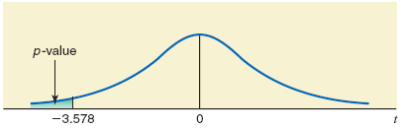
Figure 9.12 The required p-value
Prem Mann, Introductory Statistics, 7/E Copyright © 2010 John Wiley & Sons. All right reserved

Slide 98
Example 9-7
Refer to Example 9-5. A psychologist claims that the mean age at which children start walking is 12.5 months. Carol wanted to check if this claim is true. She took a random sample of 18 children and found that the mean age at which these children started walking was 12.9 months with a standard deviation of .80 month. Using the 1% significance level, can you conclude that the mean age at which all children start walking is different from 12.5 months? Assume that the ages at which all children start walking have an approximately normal distribution.
Prem Mann, Introductory Statistics, 7/E Copyright © 2010 John Wiley & Sons. All right reserved

Slide 99
Example 9-7: Solution
Step 1: H₀ : μ = 12.5
H₁ : μ ≠ 12.5
Step 2: Two tailed test
Step 3: The population standard deviation σ is not known, the sample size is small (n < 30), and the population is normally distributed. Consequently, we will use the t distribution to perform the test.
Prem Mann, Introductory Statistics, 7/E Copyright © 2010 John Wiley & Sons. All right reserved

Slide 100
Example 9-7: Solution
Step 4: Significance level = .01. The ≠ sign in the alternative hypothesis indicates that the test is two-tailed and the rejection region lies in both tails.
Area in each tail = α/2 = .01/2 = .005
df = n – 1 = 18 – 1 = 17
The critical values for t for 17 df and .005 area in each tail are -2.898 and 2.898.
Prem Mann, Introductory Statistics, 7/E Copyright © 2010 John Wiley & Sons. All right reserved

Slide 101
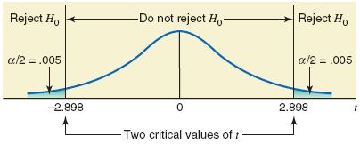
Figure 9.13 The regions
Prem Mann, Introductory Statistics, 7/E Copyright © 2010 John Wiley & Sons. All right reserved

Slide 102
Example 9-7: Solution
Step 5:
The value of the test statistic t = 2.121 falls between the two critical points, -2.898 and 2.898, which is the non-rejection region. Consequently, we fail to reject H₀.
Prem Mann, Introductory Statistics, 7/E Copyright © 2010 John Wiley & Sons. All right reserved

Slide 103
Example 9-8
The management at Massachusetts Savings Bank is always concerned about the quality of service provided to its customers. With the old computer system, a teller at this bank could serve, on average, 22 customers per hour. The management noticed that with this service rate, the waiting time for customers was too long. Recently the management of the bank installed a new computer system in the bank, expecting that it would increase the service rate and consequently make the customers happier by reducing the waiting time.
Prem Mann, Introductory Statistics, 7/E Copyright © 2010 John Wiley & Sons. All right reserved

Slide 104
Example 9-8
To check if the new computer system is more efficient than the old system, the management of the bank took a random sample of 70 hours and found that during these hours the mean number of customers served by tellers was 27 per hour with a standard deviation of 2.5. Testing at the 1% significance level, would you conclude that the new computer system is more efficient than the old computer system?
Prem Mann, Introductory Statistics, 7/E Copyright © 2010 John Wiley & Sons. All right reserved

Slide 105
Example 9-8: Solution
Step 1: H₀ : μ = 22
H₁ : μ > 22
Step 2: This is a right tailed test.
Step 3: The population standard deviation σ is not known and the sample size is large (n > 30). Consequently, we will use the t distribution to perform the test.
Prem Mann, Introductory Statistics, 7/E Copyright © 2010 John Wiley & Sons. All right reserved

Slide 106
Example 9-8: Solution
Step 4: Significance level = .01. The > sign in the alternative hypothesis indicates that the test is right-tailed and the rejection region lies in the right tail.
Area in the right tail = α = .01
df = n – 1 = 70 – 1 = 69
The critical value for t for 69 df and .01 area in the right tail is 2.382.
Prem Mann, Introductory Statistics, 7/E Copyright © 2010 John Wiley & Sons. All right reserved

Slide 107
Figure 9.14
Prem Mann, Introductory Statistics, 7/E Copyright © 2010 John Wiley & Sons. All right reserved

Slide 108
Example 9-8: Solution
Step 5:
The value of the test statistic t_{o} = 16.733 is greater than the critical value of t = 2.382, and it falls in the rejection region. Consequently, we reject H₀.
Prem Mann, Introductory Statistics, 7/E Copyright © 2010 John Wiley & Sons. All right reserved

Slide 109
Example 9-9
According to a Nationwide Mutual Insurance Company Driving While Distracted study conducted in 2008, 81% of the drivers interviewed said that they have talked on their cell phones while driving (The New York Times, July 19, 2009). The survey included drivers aged 16 to 61 years selected from 48 states. Assume that this result holds true for the 2008 population of all such drivers in the United States. In a recent random sample of 1600 drivers aged 16 to 61 years selected from the United States, 83% said that they have talked on their cell phones while driving.
Prem Mann, Introductory Statistics, 7/E Copyright © 2010 John Wiley & Sons. All right reserved

Slide 110
Example 9-9
Find the p-value to test the hypothesis that the current percentage of such drivers who have talked on their cell phones while driving is different from 81%. What is your conclusion if the significance level is 5%?
Prem Mann, Introductory Statistics, 7/E Copyright © 2010 John Wiley & Sons. All right reserved

Slide 111
Example 9-9: Solution
Step 1: H₀ : p = .81
H₁ : p ≠ .81
Step 2: This is a two tailed test.
Step 3: To check whether the sample is large, we calculate the values of np and nq:
np = 1600(.81) = 1296 > 5
nq = 1600(.19) = 304 > 5
Consequently, we will use the normal distribution to find the p-value for this test.
Prem Mann, Introductory Statistics, 7/E Copyright © 2010 John Wiley & Sons. All right reserved

Slide 112
Example 9-9: Solution
Step 4: The ≠ sign in the alternative hypothesis indicates that the test is two-tailed.
Area to the left when z = 2.04 is 0.9793. So the area to the right when z = 2.04 is 1-0.9793 = 0.0207
p-value = 2(.0207) = .0414
Prem Mann, Introductory Statistics, 7/E Copyright © 2010 John Wiley & Sons. All right reserved

Slide 113
Figure 9.15 The required p-value
Prem Mann, Introductory Statistics, 7/E Copyright © 2010 John Wiley & Sons. All right reserved

Slide 114
Example 9-9: Solution
Step 4: We can state that for any α greater than .0414 we will reject the null hypothesis. For our example, α = .05, which is greater than the p-value of .0414. As a result, we reject H₀ and conclude that the current percentage of all U.S. drivers aged 16 to 61 years who have talked on their cell phones while driving is different from .81.
Prem Mann, Introductory Statistics, 7/E Copyright © 2010 John Wiley & Sons. All right reserved

Slide 115
Example 9-10
When working properly, a machine that is used to make chips for calculators does not produce more than 4% defective chips. Whenever the machine produces more than 4% defective chips, it needs an adjustment. To check if the machine is working properly, the quality control department at the company often takes samples of chips and inspects them to determine if they are good or defective.
Prem Mann, Introductory Statistics, 7/E Copyright © 2010 John Wiley & Sons. All right reserved

Slide 116
Example 9-10
One such random sample of 200 chips taken recently from the production line contained 12 defective chips. Find the p-value to test the hypothesis whether or not the machine needs an adjustment. What would your conclusion be if the significance level is 2.5%?
Prem Mann, Introductory Statistics, 7/E Copyright © 2010 John Wiley & Sons. All right reserved

Slide 117
Example 9-10: Solution
Step 1: H₀: p ≤ .04
H₁: p > .04
Step 2: Right tailed test
Step 3: To check whether the sample is large, we calculate the values of np and nq:
np = 200(.04) = 8 > 5
nq = 200(.96) = 192 > 5
Consequently, we will use the normal distribution to find the p-value for this test.
Prem Mann, Introductory Statistics, 7/E Copyright © 2010 John Wiley & Sons. All right reserved

Slide 118
Example 9-10: Solution
Step 4: The > sign in the alternative hypothesis indicates that the test is right-tailed.
Area to the left when z = 1.44 is 0.9251. The area to the right when z = 1.44 is 1-0.9251 = 0.0749.
p-value = .0749
Prem Mann, Introductory Statistics, 7/E Copyright © 2010 John Wiley & Sons. All right reserved

Slide 119
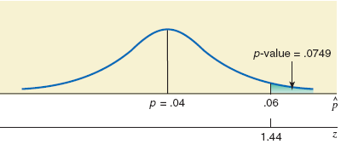
Figure 9.16 The required p-value
Prem Mann, Introductory Statistics, 7/E Copyright © 2010 John Wiley & Sons. All right reserved

Slide 120
Example 9-10: Solution
Step 4: We can state that for any α greater than .0749 we will reject the null hypothesis, and for any α less than or equal to .0749 we will not reject the null hypothesis. For our example, α = .025, which is less than the p-value of .0749. As a result, we fail to reject H₀ and conclude that the machine does not need an adjustment.
Prem Mann, Introductory Statistics, 7/E Copyright © 2010 John Wiley & Sons. All right reserved

Slide 121
Example 9-11
Refer to Example 9-9. According to a Nationwide Mutual Insurance Company Driving While Distracted Survey conducted in 2008, 81% of the drivers interviewed said that they have talked on their cell phones while driving (The New York Times, July 19, 2009). The survey included drivers aged 16 to 61 years selected from 48 states. Assume that this result holds true for the 2008 population of all such drivers in the United States. In a recent random sample of 1600 drivers aged 16 to 61 years selected from the United States, 83% said that they have talked on their cell phones while driving.
Prem Mann, Introductory Statistics, 7/E Copyright © 2010 John Wiley & Sons. All right reserved

Slide 122
Example 9-11
Using the 5% significance level, can you conclude that the current percentage of such drivers who have talked on their cell phones while driving is different from 81%.
Prem Mann, Introductory Statistics, 7/E Copyright © 2010 John Wiley & Sons. All right reserved

Slide 123
Example 9-11: Solution
Step 1: H₀ : p = .81
H₁ : p ≠ .81
Step 2: This is two tailed test
Step 3: To check whether the sample is large, we calculate the values of np and nq:
np = 1600(.81) = 1296 > 5
nq = 1600(.19) = 304 > 5
Consequently, we will use the normal distribution to make the test.
Prem Mann, Introductory Statistics, 7/E Copyright © 2010 John Wiley & Sons. All right reserved

Slide 124
Example 9-11: Solution
Step 4: The ≠ sign in the alternative hypothesis indicates that the test is two-tailed. The significance level is .05. Therefore, the total area of the two rejection regions is .05.
Area in each tail = α / 2 = .05 / 2 = .0250
The critical values of z are -1.96 and 1.96.
Prem Mann, Introductory Statistics, 7/E Copyright © 2010 John Wiley & Sons. All right reserved

Slide 125
Figure 9.17 The critical values of z
Prem Mann, Introductory Statistics, 7/E Copyright © 2010 John Wiley & Sons. All right reserved

Slide 126
Example 9-11: Solution
Step 5:
Prem Mann, Introductory Statistics, 7/E Copyright © 2010 John Wiley & Sons. All right reserved

Slide 127
Example 9-11: Solution
Step 6: the value of test statistic z = 2.04 falls in the rejection region. As a result, we reject H₀ and conclude that the current percentage of all U.S. drivers aged 16 to 61 years who have talked on their cell phones while driving is different from .81.
Prem Mann, Introductory Statistics, 7/E Copyright © 2010 John Wiley & Sons. All right reserved

Slide 128
Example 9-12
Direct Mailing Company sells computers and computer parts by mail. The company claims that at least 90% of all orders are mailed within 72 hours after they are received. The quality control department at the company often takes samples to check if this claim is valid. A recently taken sample of 150 orders showed that 129 of them were mailed within 72 hours. Do you think the company’s claim is true? Use a 2.5% significance level.
Prem Mann, Introductory Statistics, 7/E Copyright © 2010 John Wiley & Sons. All right reserved

Slide 129
Example 9-12: Solution
Step 1: H₀ : p ≥ .90
H₁ : p < .90
Step 2: Left tailed test
Step 3: To check whether the sample is large, we calculate the values of np and nq:
np = 150(.90) = 135 > 5
nq = 150(.10) = 15 > 5
Consequently, we will use the normal distribution to make the test.
Prem Mann, Introductory Statistics, 7/E Copyright © 2010 John Wiley & Sons. All right reserved

Slide 130
Example 9-12: Solution
Step 4: Significance level = .0250. The < sign in the alternative hypothesis indicates that the test is left-tailed, and the rejection region leis in the left tail.
The critical values of z for .0250 area in the left tail is -1.96.
Prem Mann, Introductory Statistics, 7/E Copyright © 2010 John Wiley & Sons. All right reserved

Slide 131
Figure 9.18 The critical values of z
Prem Mann, Introductory Statistics, 7/E Copyright © 2010 John Wiley & Sons. All right reserved

Slide 132
Example 9-12: Solution
Step 5:
Prem Mann, Introductory Statistics, 7/E Copyright © 2010 John Wiley & Sons. All right reserved

Slide 133
Example 9-12: Solution
Step 5: The value of test statistic z = -1.63 is greater than the critical value of z = -1.96, and it falls in the nonrejection region. Therefore, we fail to reject H₀.
Prem Mann, Introductory Statistics, 7/E Copyright © 2010 John Wiley & Sons. All right reserved

